Slide 1
Product Use Management
MTN 020 Training

Slide 2
Objectives- study product tab
Identify the conditions that would require a product hold or discontinuation
Review conditions that require follow up per protocol before product resumed
Role of the PSRT in assisting with clinical management and per protocol requirements
Notes:
In training binder, section “Study Product” as all reasons for product hold and safety flow sheets will be provided in there.

Slide 3
Product Hold vs. Permanent Discontinuation
Some product holds will be temporary, with product use resumed after time has elapsed
Pregnancy, for example
Some holds will turn into permanent discontinuations
Positive rapid HIV test, confirmed, for example
All are clinical, that is, initiated by study staff

Slide 4
Criteria for Permanent Discontinuation of Study Product
A participant will be permanently discontinued from VR product use automatically
Acquisition of HIV-1 infection (confirmed)
Allergic reaction to the VR

Slide 5
Acquisition of HIV-infection
Initiate product hold IMMEDIATELY with first reactive rapid HIV test (on same day as result)
If the participant is determined to be HIV-uninfected, resume product use
Permanently discontinue the study VR if HIV-1 infection is confirmed

Slide 7
General Criteria for Automatic Product Hold Initiation
Reactive rapid HIV test
Pregnancy (per positive urine test result)
Breastfeeding (per ppt report)
Ppt report of use of PEP for HIV exposure
Grade 3 related AE
Grade 4 AE, regardless of relationship to study product
Participant is unable or unwilling to comply with required study procedures, or otherwise might be put at undue risk to their safety and well-being by continuing product use, according to the judgment of the IoR/designee*
Protocol version 1.0 Section 9.3
Notes:
For last one, PSRT consult

Slide 11
Guidance with Regard to AEs
General guidance
Specific AEs addressed in section 9.5
Sexually Transmitted Infections

Slide 12
General AEs by Grade
AE addressed in Section 9.5
CONTINUE PRODUCT
GRADE 1 & 2 AEs
GRADE 3 AEs
unrelated
INITIATE HOLD
related
Follow relevant protocol section
GRADE 4 AEs

Slide 13
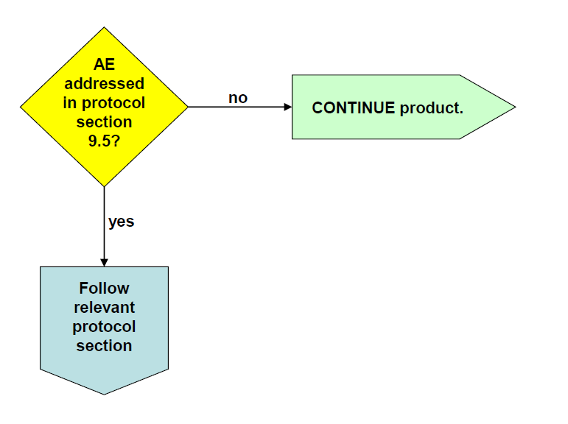
Grade 1 or 2 Adverse Events

Slide 14
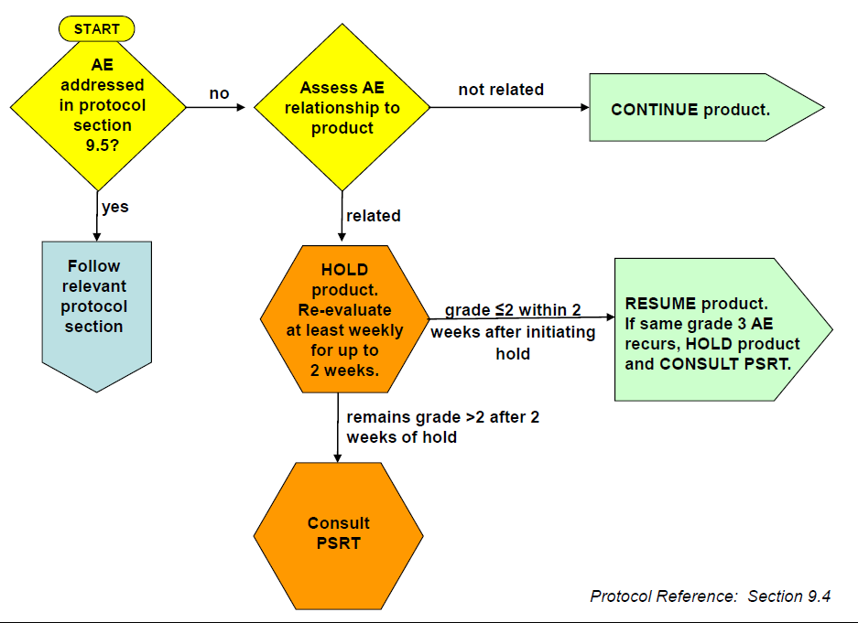
Grade 3 Adverse Events

Slide 15
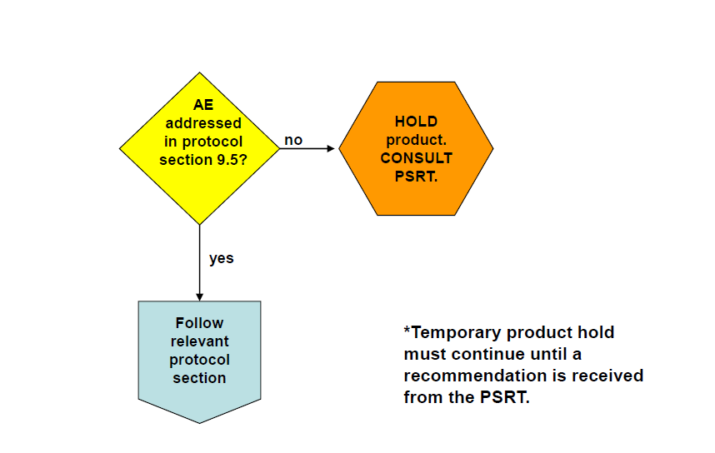
Grade 4 Adverse Events
Protocol reference section 9.3

Slide 16
Instruction Regarding Specific AEs
Superficial epithelial disruption
Deep epithelial disruption
Localized erythema or edema
Generalized erythema or severe edema
Unexpected genital bleeding
Cervicitis (including findings on exam such as inflammation and/or friability)
Genital petechiae
Genital ecchymosis
Protocol reference Section 9.5

Slide 18
Notes:
Difference from superficial, shorter re-evaluation time. Recurrence prompts PSRT consultation
Discuss with team mechanisms to get the participant back within this short time frame
These events are NOT expected to be common AT ALL.

Slide 20
Notes:
Difference – short re-evaluation time and recurrence prompts PSRT consultation

Slide 21
N.B IoR/designee can opt to hold study product per his/her discretion, PSRT consult required

Slide 23
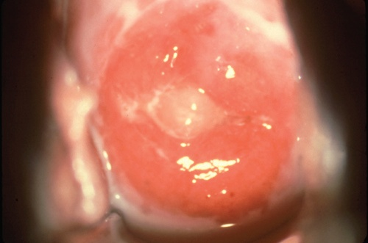
Cervicitis

Slide 25
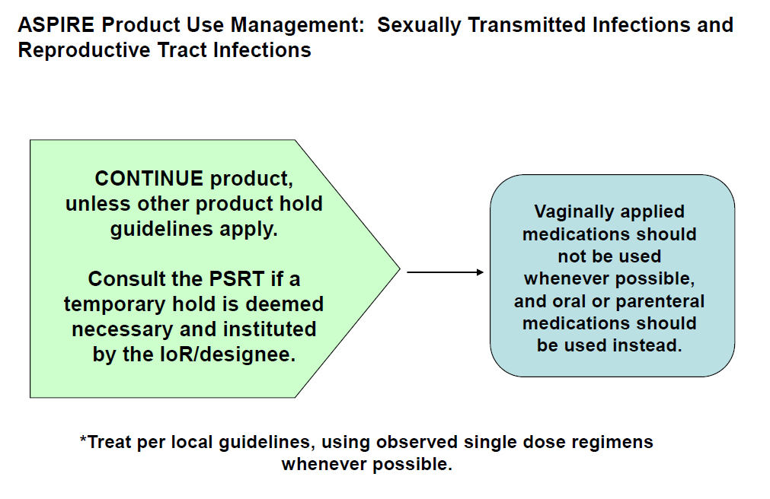

Slide 26
Other Temporary Product Holds
Co-enrollment in another study identified
Participation non compliance
Colposcopic examination for abnormal cervical cytology
Remove on day of procedure
Resume after colpo if not biopsy performed
Resume after pelvic exam at site if biopsy performed

Slide 27
Case 1
26 year old female has a pelvic exam and pap smear performed at her month 6 visit as follow up from an abnormal pap prior to enrollment
The pap smear reveals LSIL
Should product be held?

Slide 28
Answer: Depends
LSIL on cervical cytology is categorized as a grade 2 AE per the DAIDS female genital toxicity table and based on the protocol this would not require product hold
However, If local standard of care requires colposcopy, a temporary product hold should be instituted on the day of colposcopy.
If local standard of care does not require colposcopy, product should be continued
How long the hold continues after colposcopy depends on whether a biopsy was obtained

Slide 29
Case 1- continued
Local standard of care requires colposcopic examination
Product is held the day of colposcopy
Biopsy is performed, revealing CIN-1
No treatment is recommended
When can product be resumed? What action needs to be taken before product can be resumed?

Slide 30
Case 1
The period of temporary hold should continue until a clinically acceptable resolution for the biopsy and/or treatment has occurred according to the judgment of the IoR/designee.
Adequate healing should be confirmed on pelvic examination prior to reinstating product use
7 days for healing after biopsy should be sufficient
If no other contraindications are seen on pelvic exam, product may be resumed

Slide 31
Case 2
A 26 year old woman presents for an interim visit after Month 6. She has had regular menstrual cycles for the past several years, but for the past two days she has noted inter-menstrual bleeding. She denies pain, fever, or any other associated symptoms?

Slide 32
Case 2
Is a product hold warranted?
Depends
On pelvic exam, you see a 3 cm long deep laceration on the right vaginal wall
Now what?
Product hold is indicated
What is the AE?
When will you see her back?
Notes:
Depends- she should undergo a pelvic exam. If there is no abnormal pelvic exam finding to explain the bleeding and no other contraindication to product use, she should continue product.

Slide 33
PSRT (Protocol Safety Review Team)
The protocol co-chairs, DAIDS medical officer, IPM medical officers, MTN safety physicians, and data center representatives comprise the PSRT
Respond to clinical, protocol mandated, and administrative queries (72 hour turnaround time)
Provide support to the clinical sites in a manner that is both permissive and consistent with the protocol

Slide 34
PSRT Query Process
Site submits query
PSPs draft response
PSRT comments
PSPs finalize response
Response back to site
Email to mtn020safetymd@mtnstopshiv.org
72 hours
Notes:
34

Slide 35
When to Consult the PSRT
Notify the PSRT for all product holds related to Grade 4 AEs
Re-occurrence or persistence of Grade 3 AEs
Persistence of “specific” AEs
deep epithelial disruption or ulceration
generalized erythema and edema
GC/chlamydia positive cervicitis
All holds not otherwise specified by protocol

Slide 36
PSRT Query Documentation
All PSRT queries (with PSRT response included) should be filed in the participant binder
This is considered key communication from the study team and guidance received should be filed

Slide 37
Safety Physicians
mtnsafetymd@mtnstopshiv.org
24 hour safety phone- see SSP
Please email with any questions, concerns, comments!
All emails welcome!!

Slide 38
What Are Your Questions?

